Slide 1
Analysis on weather obstruction hampering scoring performance during the 2018 NFL season
Team 8
Aaron Hyungbin Woo, Connor Vergara, David Edwards.

Slide 2



Methodology:
Objective:
A total of 256 games were analyzed to uncover patterns between NFL team performance during varying weather changes.
Would temperature affect scoring, run/pass ratio, fumbles, or dropped passes.
Does wind speed affect kicking percentage, and run/pass ratio
Goal:
Our goal is to confirm or deny the old adage of weather affecting scoring performance.
This will involve using Google API, Dark Sky API, and MySportsFeeds API to coordinates, game results and weather outcomes for each game day.
Would precipitation affect fumbles, dropped passes, and run/pass ratio.
Does sun/cloud intensity affect percentage of dropped passes.
# of Stadiums: 32
# of Stadiums with Open Roofs: 24
# of Stadiums with Closed Roofs: 8

Slide 3
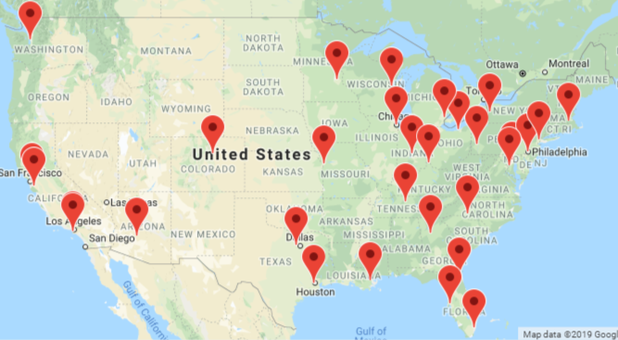
Map of Stadiums
Stadiums
Arrowhead Stadium | Lucas Oil Stadium
AT&T Stadium | M&T Bank Stadium
Bank of America Stadium | Mercedes-Benz Stadium
Broncos Stadium at Mile High | Mercedes-Benz Superdome
CenturyLink Field | MetLife Stadium
Dignity Health Sports Park | New Era Field
FedEx Field | Nissan Stadium
FirstEnergy Stadium | NRG Stadium
Ford Field | Oakland-Alameda County Coliseum
Gillette Stadium | Paul Brown Stadium
Hard Rock Stadium | Raymond James Stadium
Heinz Field | Soldier Field
Lambeau Field | State Farm Stadium
Levi's Stadium | TIAA Bank Field
Lincoln Financial Field | US Bank Stadium
Los Angeles Memorial Coliseum | Wembley Stadium

Slide 4
Data clean up & analysis

Slide 5
Xx
Xx
Xx
Xx

Slide 6
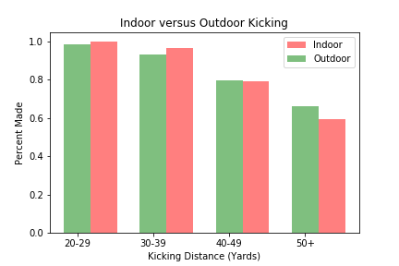
Field Goal Accuracy
- Information was gathered using the MySportsFeed Api, aggregation and data cleanup was done using PandasDB and graphs were created in MatPlotLib
- Accuracy drops off as expected as distance increases
- As expected the Indoor kicking accuracy was as good or better than Outdoor accuracy with the exception of 50+ yards
- Further analysis could reveal the reason why long distance kicking dropped off past 50 yards

Slide 7
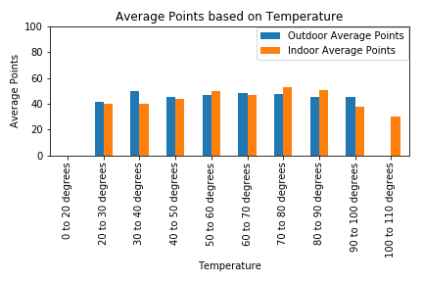
Average Points by Temperature
This data was gathered by appending temperature data gathered by DarkSky API with MySportsFeed API. From there we filtered team scores by Open and Covered Stadiums and plotted the average scores
Open roof stadiums appear to perform slightly better in extreme temperatures in comparison to closed dome stadiums.

Slide 8
Overall Findings
A surprise finding was that long range kicking accuracy was actually worse in Dome stadiums compared to outdoor stadiums.
Open roof stadiums appear to score more points on average. However more data would help solidify the validity of this assumption.
The Patriots are winning the Super Bowl. The magnificence of Tom Brady is all the data you need.

Slide 9
Difficulties, and additional questions
Converting time formats pulled from one data to another.
Limitations of precise data for certain stats did not allow for more detailed analysis.
A lack of year over year data has limited us in making additional findings of significance.

Slide 10
End Page
Team 8
Aaron Hyungbin Woo Connor Vergara David Edwards

